Slide 1

SQL Management Studio
Adventure Works 2012
Documentation - Best Practices
Version 1.0
Shrikesh Pattni

Slide 2
How we should think of Master Metadata Management
Data Warehouse
Volume: SQL Tables, Dev/Test/Production
Volume: 3,000 + data assets in enterprise heavy data projects
Velocity: Data is updated daily/weekly with increments
Variety: Increase in complexity of relationships/data types
Veracity: Daily backups/Version control enables quality
Value: Timestamp data attributes,
Metadata/Governance
Value: Removing confusion by understanding data definitions
Value: Better levels of completeness/accuracy/row count of data
Value: Removing assumptions and guess work on data structure
Value: Better levels of performance optimisations on data assets
Value: Increase confidence to technical/non technical stakeholders
Value : *All above resulting In better communication channels*
Data Warehouse
Data Taxonomy
Variety: Classification of data assets into valuable entities
Value: Data Dictionary enables better levels of insights
Veracity: Increase data trust to increase value and engagement
Veracity: Remove biased and falsification (integer value column)
Metadata/Governance
Value Creation
Value: Richer, tangible value around Data Analytics
Value: Team engagement, active as opposed to reactive culture
Value: Internal/External operational value add changes
Value: Performance Optimisations on data assets
Taxonomy
Value Creation

Slide 3

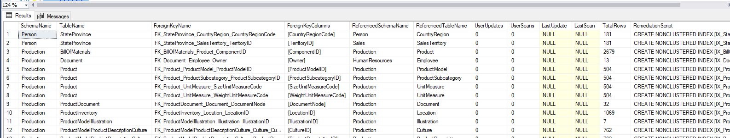
Find all Foreign Keys without corresponding indexes with an included remediation script to run after
00
Shrikesh Pattni

Slide 4
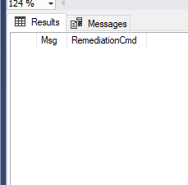
Check is “Always On Health State”
01
Shrikesh Pattni

Slide 5
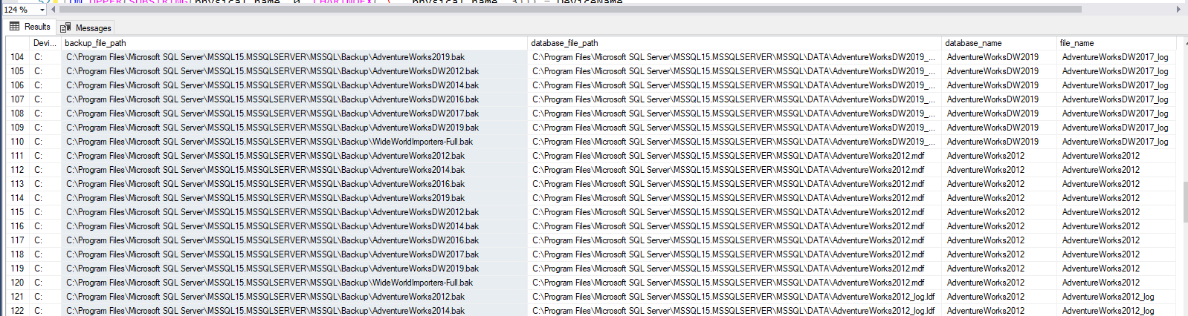
Backup DB files, same physical volume
02
Shrikesh Pattni

Slide 6
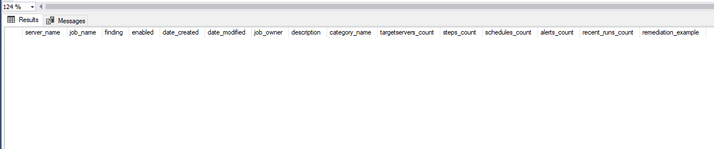
Find out “Badly Configured SQL Agent Jobs”
03
Shrikesh Pattni

Slide 7
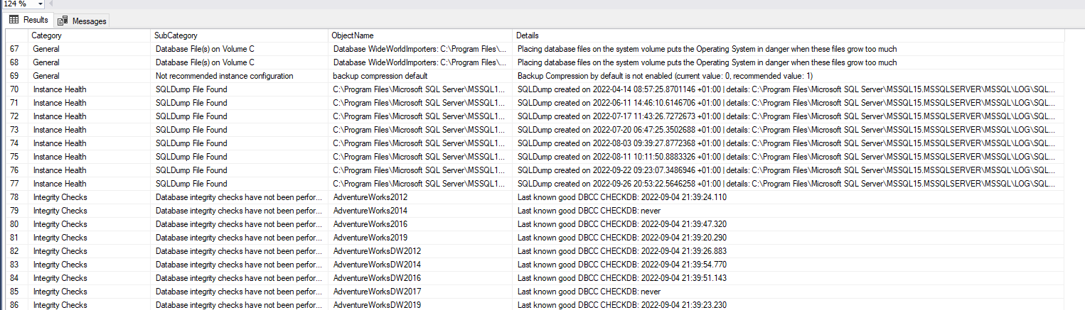
Assess and validate the integrity of a database based on following categories:
Database Backups
Database Compatibility Mismatch
Genera Databases saved on C Drive
Instance Health (SQL Dump Files finding(
Integrity checks
Resources (memory checks)
Security checks (TCPIP Port)
04
Shrikesh Pattni

Slide 8
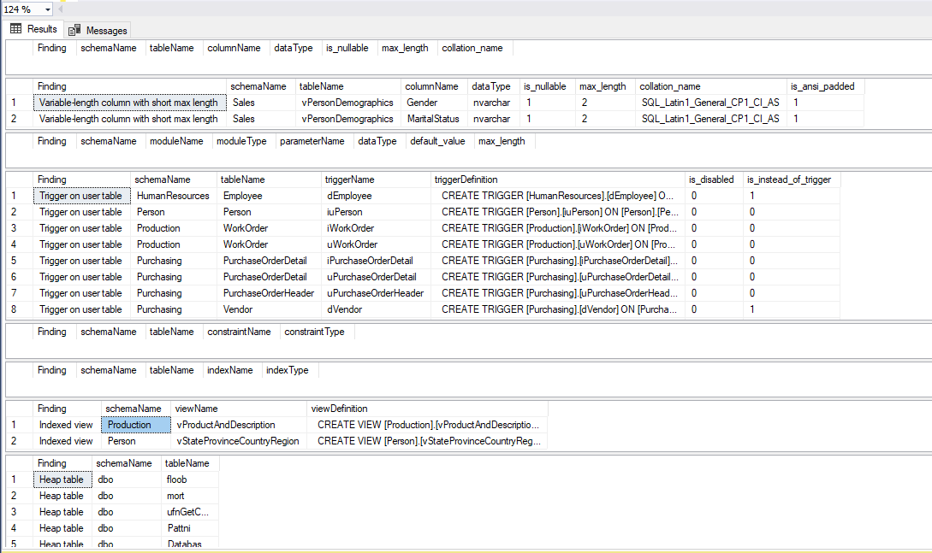
Database Design Best Practice Checks
05
Shrikesh Pattni

Slide 9
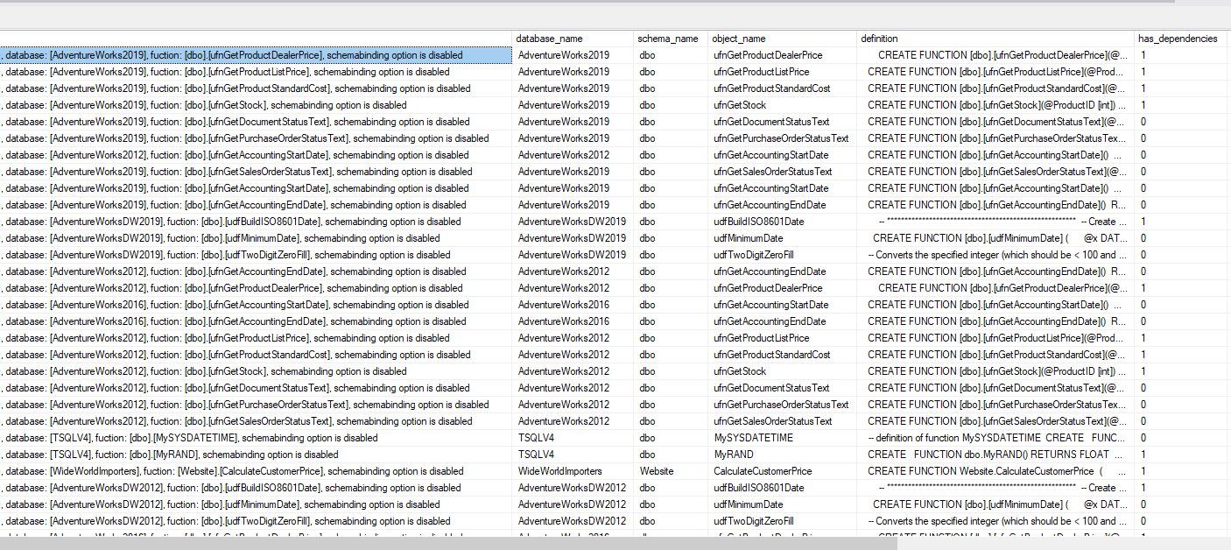
Find all tables where Schema binding is disabled
06
Shrikesh Pattni

Slide 10
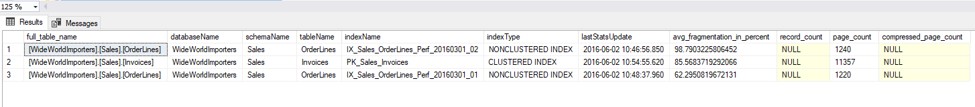
which tables have index fragmentation
07
Shrikesh Pattni

Slide 11
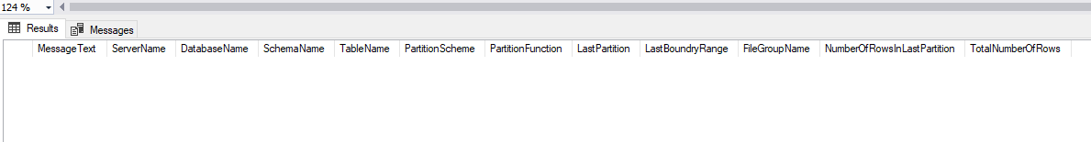
What is the output of “Last Partition Not Empty” for all tables in a database
08
Shrikesh Pattni

Slide 12
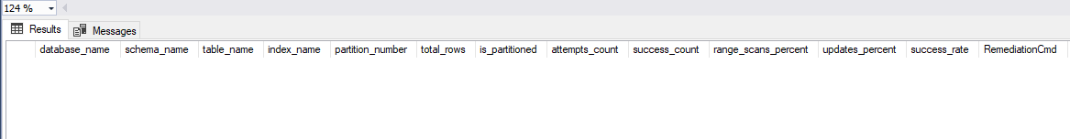
Low PAGE Compression Success Rates
09
Shrikesh Pattni

Slide 13
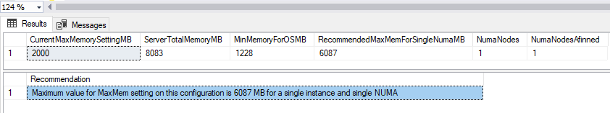
Find out the current and recommended Max Memory for my server
10
Shrikesh Pattni

Slide 14
Find out the current and recommended Max Memory for my server
11
Shrikesh Pattni

Slide 15

Get detailed information on all Redundant Indexes on a Databases
12
Shrikesh Pattni

Slide 16

Get summary information on all Redundant Indexes on a Databases
13
Shrikesh Pattni

Slide 17
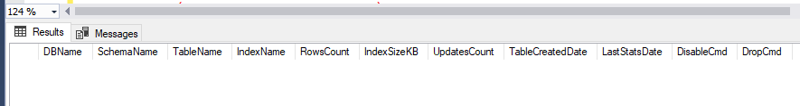
Get summary of all unused indexes
14
Shrikesh Pattni

Slide 18
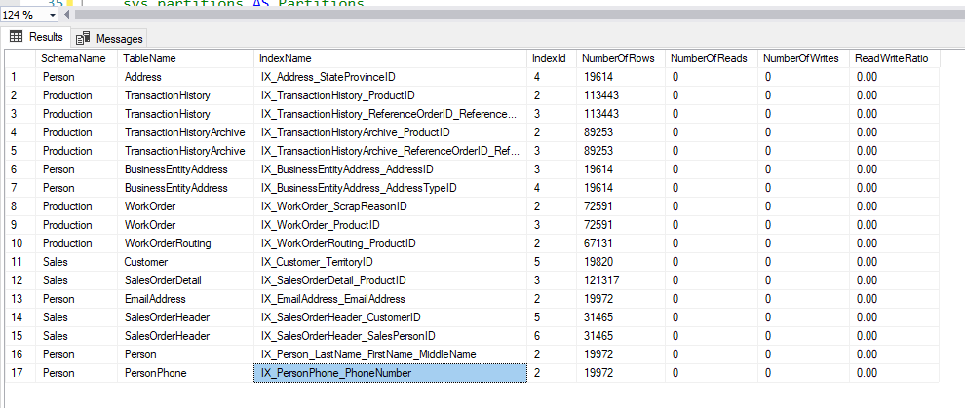
Get summary of all indexes reads and writes
15
Shrikesh Pattni

Slide 19
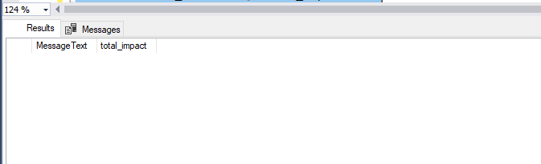
Missing Indexes with Highest Impact
16
Shrikesh Pattni

Slide 20
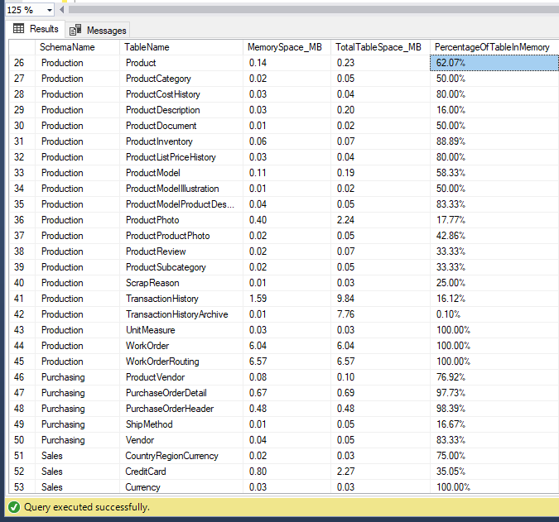
Find out % of Table Memory
17
Shrikesh Pattni

Slide 21
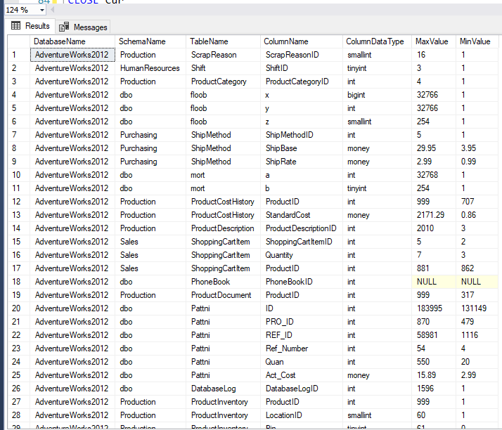
Get Max/Min Values for all the columns for all the tables
18
Shrikesh Pattni

Slide 22
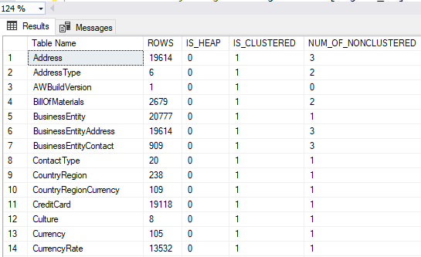
Find out which tables are HEAP, Clustered or Non-Clustered types
19
Shrikesh Pattni

Slide 23
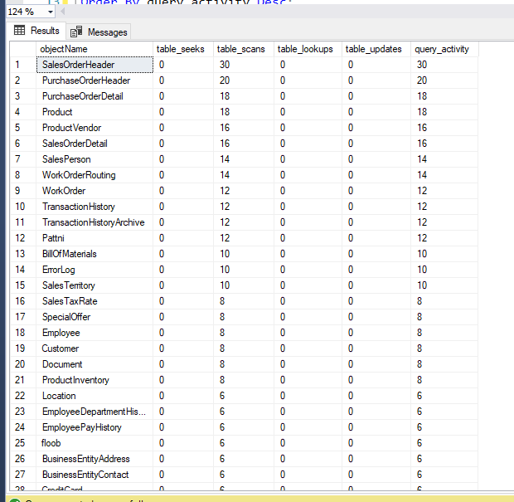
Find the most expensive tables
20
Shrikesh Pattni

Slide 24
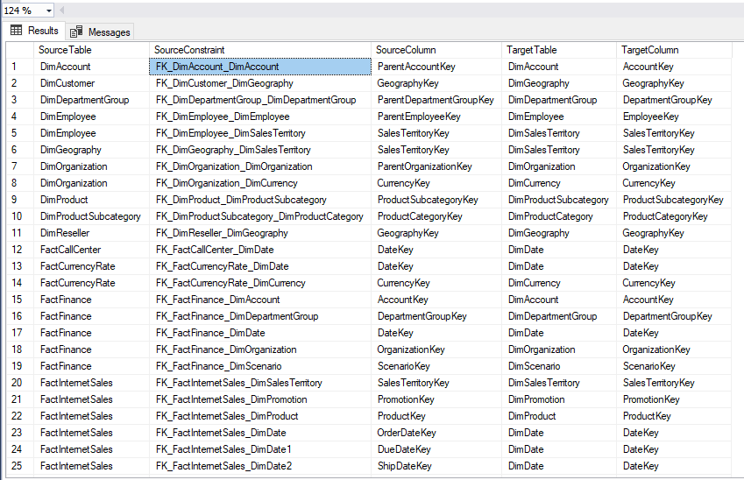
Find Foreign key References
21
Shrikesh Pattni

